Slide 1
UPPER SIXTH ARTS
GEOGRAPHY
Lesson 15: Types of Migration
Types of Migration
Notes:
Good morning, class, and welcome to our geography lesson. I am your geography teacher, Mr Kamdem. Today we are starting Lesson 15: Types of Migration.

Slide 2
CLASS INFO
Class, Chapter and Duration
Class | Upper Sixth Arts
Chapter | Module 4: Understanding and managing population dynamics across the world in general and Cameroon in particular
Duration | 2 periods (2 × 50 minutes)
Notes:
This lesson is for Upper Sixth Arts. It belongs to Module 4: Understanding and managing population dynamics across the world in general and Cameroon in particular. We shall need 2 periods to cover it.

Slide 3
IDENTIFICATION
Lesson Identification
Topic | Population Change over Space (Migration)
Sub-topic | Migration Types
Lesson | Lesson 15: Types of Migration
Notions / Concepts | Voluntary migration, forced migration, internal migration, international migration, refugee, IDP, commuting, push and pull factors.
Syllabus focus | Voluntary and forced; internal (rural-urban, rural-rural, urban-rural, intra-urban, inter-urban, commuting); international; refugees and IDPs; push and pull factors; consequences.
Competence | Learners are able to classify migrations and explain their causes and consequences.
Notes:
Our topic is Population Change over Space (Migration), and the sub-topic is Migration Types. The key notions we shall use today are: voluntary migration, forced migration, internal migration, international migration, refugee, IDP, commuting, push and pull factors. At the end, you should be able to do this: learners are able to classify migrations and explain their causes and consequences.

Slide 4

HOMEWORK CORRECTION
Correction of the Homework
Question (Lesson 14: Spatial Interaction):
List goods that come to your town from other regions and say why.
Notes:
Before we start the new lesson, let us correct the homework I gave you at the end of Lesson 14: Spatial Interaction. The question was: List goods that come to your town from other regions and say why. Take out your exercise books.

Slide 5
HOMEWORK CORRECTION
Correction: Possible Answer
Examples: onions and cattle come from the North; plantains, palm oil and kola nuts from the South and West; manufactured goods from Douala. This is due to complementarity between regions.
Notes:
Here is a good answer. Examples: onions and cattle come from the North; plantains, palm oil and kola nuts from the South and West; manufactured goods from Douala. This is due to complementarity between regions. Compare it with your own answer and correct your work in red.

Slide 6
LESSON PLAN
Lesson Plan
Correction of the homework
Objectives and recall
Real-life situation and action to take
Learning activities
Board summary
Evaluation, remediation and homework
Notes:
Here is the plan of our lesson today. First, we shall correct the homework. Then we shall look at the objectives and recall what you already know. After that, we shall study a situation from real life and the action to take, and do the learning activities. Finally, we shall copy the board summary, do the evaluation and the remediation, and I will give you the homework.

Slide 7
OBJECTIVES
Objectives
By the end of this lesson, you should be able to:
Classify migration by cause and distance.
Explain push and pull factors.
Explain the consequences of migration at source and destination.
Notes:
By the end of this lesson, you should be able to do three things. Number 1: classify migration by cause and distance. Number 2: explain push and pull factors. Number 3: explain the consequences of migration at source and destination.

Slide 8
PREVIOUS KNOWLEDGE
Previous Knowledge
Migration is a change of residence.
Most migrants move short distances.
Notes:
Let us first remember what you already know. Migration is a change of residence. Most migrants move short distances. Keep this in mind, because we shall build on it today.

Slide 9
REAL-LIFE SITUATION
Situation in Real Life
A young man from a village near Bafoussam moves to Douala to find work. His cousin crossed the Mediterranean to Europe. In the North-West, thousands of families fled insecurity to other regions.
Notes:
Listen carefully to this situation from real life. A young man from a village near Bafoussam moves to Douala to find work. His cousin crossed the Mediterranean to Europe. In the North-West, thousands of families fled insecurity to other regions. Think about it, because I am going to ask you some questions.

Slide 10
REAL-LIFE SITUATION
Situation: Question 1
What is the problem in the situation?
Notes:
Question 1: What is the problem in the situation? Think for a moment, then raise your hand to answer.

Slide 11
REAL-LIFE SITUATION
Answer
People migrate for different reasons and to different places.
Notes:
Good. People migrate for different reasons and to different places.

Slide 12
REAL-LIFE SITUATION
Situation: Question 2
Which move is forced?
Notes:
Question 2: Which move is forced? Think for a moment, then raise your hand to answer.

Slide 13
REAL-LIFE SITUATION
Answer
Fleeing insecurity.
Notes:
Good. Fleeing insecurity.

Slide 14
REAL-LIFE SITUATION
Situation: Question 3
Which move is international?
Notes:
Question 3: Which move is international? Think for a moment, then raise your hand to answer.

Slide 15
REAL-LIFE SITUATION
Possible Answer
The cousin who went to Europe.
Notes:
Good. The cousin who went to Europe.

Slide 16
ACTION TO TAKE
Action to Take
Manage migration so that it benefits both source and destination areas.
Notes:
From this situation, the action we are working towards in this lesson is the following: manage migration so that it benefits both source and destination areas.

Slide 17
JUSTIFICATION
Justification of the Lesson
This lesson helps us to understand the many forms of migration and their effects.
Notes:
Why is this lesson important for you? This lesson helps us to understand the many forms of migration and their effects.

Slide 18
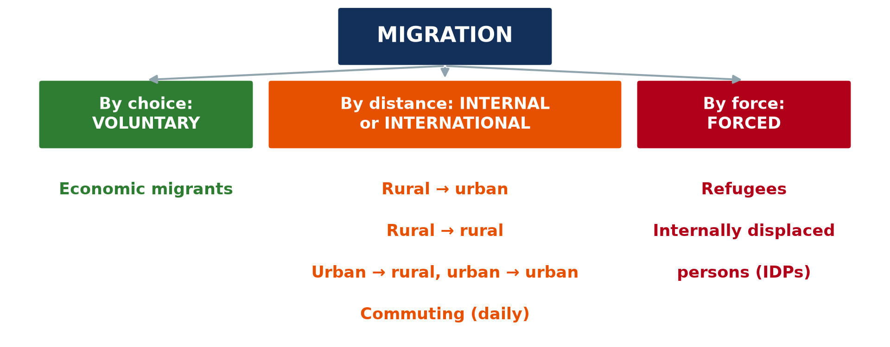
1. VOLUNTARY AND FORCED MIGRATION
Activity 1
Types of migration.
Notes:
Activity 1. Look carefully at this diagram: types of migration. Observe every detail before I ask the question.

Slide 19
1. VOLUNTARY AND FORCED MIGRATION
Activity 1: Question
Distinguish internal and international migration.
Notes:
Here is the question for Activity 1: Distinguish internal and international migration. Take one minute to think and write your answer in your rough notebook.

Slide 20
1. VOLUNTARY AND FORCED MIGRATION
Activity 1: Answer
Internal is within a country; international crosses borders.
Notes:
Let us check the answer together. Internal is within a country; international crosses borders.

Slide 21

2. INTERNAL MIGRATION
Activity 2
Douala.
Notes:
Activity 2. Look carefully at this picture: douala. Observe every detail before I ask the question.

Slide 22
2. INTERNAL MIGRATION
Activity 2: Question
Give two pull factors of Douala.
Notes:
Here is the question for Activity 2: Give two pull factors of Douala. Take one minute to think and write your answer in your rough notebook.

Slide 23
2. INTERNAL MIGRATION
Activity 2: Answer
Jobs and better services (schools, hospitals, electricity).
Notes:
Let us check the answer together. Jobs and better services (schools, hospitals, electricity).

Slide 24
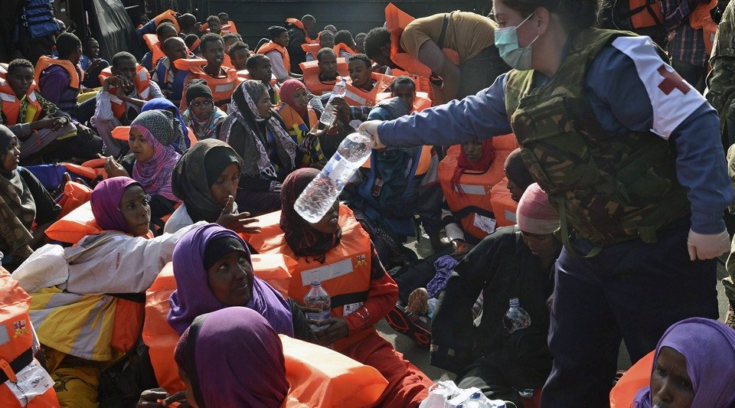
3. INTERNATIONAL MIGRATION
Activity 3
Migrants rescued in the Mediterranean.
Notes:
Activity 3. Look carefully at this picture: migrants rescued in the Mediterranean. Observe every detail before I ask the question.

Slide 25
3. INTERNATIONAL MIGRATION
Activity 3: Question
Give one positive and one negative consequence for the source country.
Notes:
Here is the question for Activity 3: Give one positive and one negative consequence for the source country. Take one minute to think and write your answer in your rough notebook.

Slide 26
3. INTERNATIONAL MIGRATION
Activity 3: Answer
Positive: money sent home (remittances). Negative: loss of young workers (brain drain).
Notes:
Let us check the answer together. Positive: money sent home (remittances). Negative: loss of young workers (brain drain).

Slide 27

4. FORCED MIGRATION
Activity 4
Refugees in a camp in Chad.
Notes:
Activity 4. Look carefully at this picture: refugees in a camp in Chad. Observe every detail before I ask the question.

Slide 28
4. FORCED MIGRATION
Activity 4: Question
Distinguish a refugee and an internally displaced person.
Notes:
Here is the question for Activity 4: Distinguish a refugee and an internally displaced person. Take one minute to think and write your answer in your rough notebook.

Slide 29
4. FORCED MIGRATION
Activity 4: Answer
A refugee crosses a border; an IDP stays inside his country.
Notes:
Let us check the answer together. A refugee crosses a border; an IDP stays inside his country.

Slide 30

5. CONSEQUENCES
Activity 5
Main migration flows in Cameroon (simplified).
Notes:
Activity 5. Look carefully at this diagram: main migration flows in Cameroon (simplified). Observe every detail before I ask the question.

Slide 31
5. CONSEQUENCES
Activity 5: Question
Give one consequence of migration for destination towns.
Notes:
Here is the question for Activity 5: Give one consequence of migration for destination towns. Take one minute to think and write your answer in your rough notebook.

Slide 32
5. CONSEQUENCES
Activity 5: Answer
Rapid growth, slums and pressure on services (also more workers).
Notes:
Let us check the answer together. Rapid growth, slums and pressure on services (also more workers).

Slide 33
BOARD SUMMARY
Board Summary
Topic: Population Change over Space (Migration)
Sub-topic: Migration Types
Lesson 15: Types of Migration
Notes:
Now we are going to copy the board summary. Write the title and the headings neatly in your notebooks. I will give you enough time for each slide, so do not rush.

Slide 34
BOARD SUMMARY
DEFINITIONS
The key terms of this lesson are defined as follows:
Push factors: They are the negative conditions that make people leave a place.
Pull factors: They are the attractive conditions that draw people to a place.
Notes:
Let us copy the definitions. The key terms of this lesson are defined as follows. On this slide we have Push factors and Pull factors. Write each point on a new line, with the key term first, and explain it in your own words when we revise.

Slide 35
BOARD SUMMARY
1. Voluntary Internal Migration
The main types of internal migration are:
Rural–urban migration: People move from villages to towns, pushed by poverty and poor services and pulled by jobs and schools. It is the main type in Cameroon (to Douala and Yaoundé).
Notes:
Let us copy Voluntary Internal Migration. The main types of internal migration are. On this slide we have Rural–urban migration. Write each point on a new line, with the key term first, and explain it in your own words when we revise. When you finish, we go to the next slide.

Slide 36
BOARD SUMMARY
1. Voluntary Internal Migration (continued)
Rural–rural and urban–rural migration: Farmers move to new farmland, as in the Mungo or around Lagdo. Retired people and some workers return to villages.
Notes:
We continue with Voluntary Internal Migration. On this slide we have Rural–rural and urban–rural migration. Write each point on a new line, with the key term first, and explain it in your own words when we revise. When you finish, we go to the next slide.

Slide 37
BOARD SUMMARY
1. Voluntary Internal Migration (continued)
Intra-urban, inter-urban migration and commuting: People move within or between towns for housing and jobs. Commuting is a daily movement between home and work.
Notes:
We continue with Voluntary Internal Migration. On this slide we have Intra-urban, inter-urban migration and commuting. Write each point on a new line, with the key term first, and explain it in your own words when we revise.

Slide 38
BOARD SUMMARY
2. International and Forced Migration
Other forms of migration are:
Economic migrants: They move abroad for jobs and higher incomes, for example from Cameroon to Europe or Gabon. They send money (remittances) home.
Notes:
Let us copy International and Forced Migration. Other forms of migration are. On this slide we have Economic migrants. Write each point on a new line, with the key term first, and explain it in your own words when we revise. When you finish, we go to the next slide.

Slide 39
BOARD SUMMARY
2. International and Forced Migration (continued)
Political migrants and refugees: Refugees flee persecution or war across borders, like those from the Central African Republic in eastern Cameroon. They live in camps such as Gado.
Notes:
We continue with International and Forced Migration. On this slide we have Political migrants and refugees. Write each point on a new line, with the key term first, and explain it in your own words when we revise. When you finish, we go to the next slide.

Slide 40
BOARD SUMMARY
2. International and Forced Migration (continued)
Internally displaced persons (IDPs): They flee violence but remain inside their country. The crises in the Far North and the North-West and South-West regions displaced many people.
Notes:
We continue with International and Forced Migration. On this slide we have Internally displaced persons (IDPs). Write each point on a new line, with the key term first, and explain it in your own words when we revise.

Slide 41
BOARD SUMMARY
2. International and Forced Migration
Illustration: types of migration
Notes:
Now draw this illustration in your notebook: types of migration. Give it a title and label it clearly.

Slide 42
BOARD SUMMARY
3. Consequences of Migration
Migration has consequences for source and destination areas:
At the source: Positive: remittances and less pressure on land. Negative: loss of young workers, ageing villages and brain drain.
Notes:
Let us copy Consequences of Migration. Migration has consequences for source and destination areas. On this slide we have At the source. Write each point on a new line, with the key term first, and explain it in your own words when we revise. When you finish, we go to the next slide.

Slide 43
BOARD SUMMARY
3. Consequences of Migration (continued)
At the destination: Positive: labour and skills for the economy. Negative: overcrowding, slums, unemployment and pressure on services.
Notes:
We continue with Consequences of Migration. On this slide we have At the destination. Write each point on a new line, with the key term first, and explain it in your own words when we revise.

Slide 44
BOARD SUMMARY
3. Consequences of Migration
Illustration: migration flows in Cameroon
Notes:
Now draw this illustration in your notebook: migration flows in Cameroon. Give it a title and label it clearly.

Slide 45
FORMATIVE EVALUATION
Evaluation 1
Give two push and two pull factors of rural-urban migration.
Notes:
Now let us check what you have understood. Question 1: Give two push and two pull factors of rural-urban migration. Answer in your exercise book.

Slide 46
FORMATIVE EVALUATION
Expected Answer
Push: poverty, lack of services. Pull: jobs, schools and hospitals.
Notes:
The expected answer is: push: poverty, lack of services. Pull: jobs, schools and hospitals. If you got it right, well done.

Slide 47
FORMATIVE EVALUATION
Evaluation 2
Distinguish refugees and IDPs.
Notes:
Now let us check what you have understood. Question 2: Distinguish refugees and IDPs. Answer in your exercise book.

Slide 48
FORMATIVE EVALUATION
Expected Answer
Refugees cross a border; IDPs remain in their own country.
Notes:
The expected answer is: refugees cross a border; IDPs remain in their own country. If you got it right, well done.

Slide 49
REMEDIATION
Remediation
Fill in the blanks:
Something that attracts migrants is a ______ factor.
Money sent home by migrants is ______.
Daily travel to work is ______.
Notes:
For those who need more practice, fill in the blanks in your exercise book. The answers are: number 1, pull; number 2, remittances; number 3, commuting.

Slide 50
HOMEWORK
Homework
Make a table of push and pull factors for a migrant from your village to a town.
Notes:
For your homework: Make a table of push and pull factors for a migrant from your village to a town. We shall correct it at the beginning of our next lesson.

Slide 51
NEXT LESSON
Next Lesson
Our next lesson will be on:
Lesson 16: Carrying Capacity
Notes:
Our next lesson will be on Lesson 16: Carrying Capacity. Thank you for your attention, and see you next time.

Slide 52
BILINGUAL GAME
Bilingual Game (Jeu Bilingue)
English | Français
Push factor | Le facteur répulsif
Pull factor | Le facteur attractif
Refugee | Le réfugié
Displaced person | Le déplacé interne
Remittances | Les transferts de fonds
Brain drain | La fuite des cerveaux
Notes:
Let us play the bilingual game. I say a word in English, and you give me the French word. Then we do the reverse.

Slide 53
LOGBOOK
Official Logbook (1/2)
Module / Topic | Population Change over Space (Migration)
Lesson Title | Lesson 15: Types of Migration
Expected Learning Outcomes | Classify migration by cause and distance. Explain push and pull factors. Explain the consequences of migration at source and destination.
Competence | Learners are able to classify migrations and explain their causes and consequences.
Notes:
I record this information in the official logbook of the class after the lesson.

Slide 54
LOGBOOK
Official Logbook (2/2)
Matter Taught | DEFINITIONS; Voluntary Internal Migration; International and Forced Migration; Consequences of Migration.
Evaluation | Formative evaluation and remediation exercise.
Homework | Make a table of push and pull factors for a migrant from your village to a town.
Enrolment / Present / Absent | ____ / ____ / ____
Achievement | To be completed after the lesson.
Notes:
I complete the second page of the logbook: the matter taught, the evaluation, the homework and the attendance.

Slide 55
TEACHER'S NOTE
Teacher's Note
Timing: Homework correction, plan, objectives 8 min | Recall, situation, action 10 min | 5 activities 30 min | Board summary (copying) 30 min | Evaluation, remediation 10 min | Homework, next lesson 5 min | Logbook 7 min
Without the projector (Activity 1): draw the tree.
Without the projector (Activity 2): list push factors in villages.
Without the projector (Activity 3): discuss remittances.
Without the projector (Activity 4): mention IDPs in Cameroon.
Without the projector (Activity 5): describe new quarters in towns.
Notes:
This slide is for me, the teacher: it gives the timing of the lesson and what to do if the projector is not available.

Slide 56
REFERENCES
References
National Geography Syllabus, MINESEC/IGE/IP-SS, 2019 — Module 4 (Population Geography).
Photo, Activity 2: “Douala” by christing-O-, CC BY 2.0, via Flickr (https://www.flickr.com/photos/76187282@N00/7227535754)
Photo, Activity 3: “A sailor from HMS BULWARK hands out water to rescued individuals on a ” by Royal Navy Media Archive, CC BY-NC 2.0, via Flickr (https://www.flickr.com/photos/69974959@N03/17374754690)
Photo, Activity 4: “Secretary-General Visits Refugee Camps in Chad” by United Nations Photo, CC BY-NC-ND 2.0, via Flickr (https://www.flickr.com/photos/35483578@N03/6140060599)
Diagrams and animations: drawn for this lesson (Geography Department).
Notes:
These are the references and picture credits used to prepare this lesson.

